Slide 1

Introduction
The bank loan project encompasses a comprehensive examination of lending patterns, risk assessments, and borrower behaviors. Through a series of 20 detailed visualizations, we gain insights into how different factors such as loan purpose, seasonality, credit grades, and borrower's homeownership status influence the dynamics of loan funding and repayment.

Slide 2

Objective
The primary objective of the project is to analyze bank loan data to understand the underlying trends and risk factors in lending activities. It seeks to identify the drivers of loan defaults, the correlation between creditworthiness and interest rates, and the distribution of loan purposes among borrowers.

Slide 3

Goal
The goal of this project is to utilize data-driven insights to improve the bank's lending strategies, enhance risk management, and tailor financial products to meet the specific needs of different borrower segments. By achieving a deeper understanding of these elements, the bank can make informed decisions to optimize its loan portfolio performance.

Slide 4

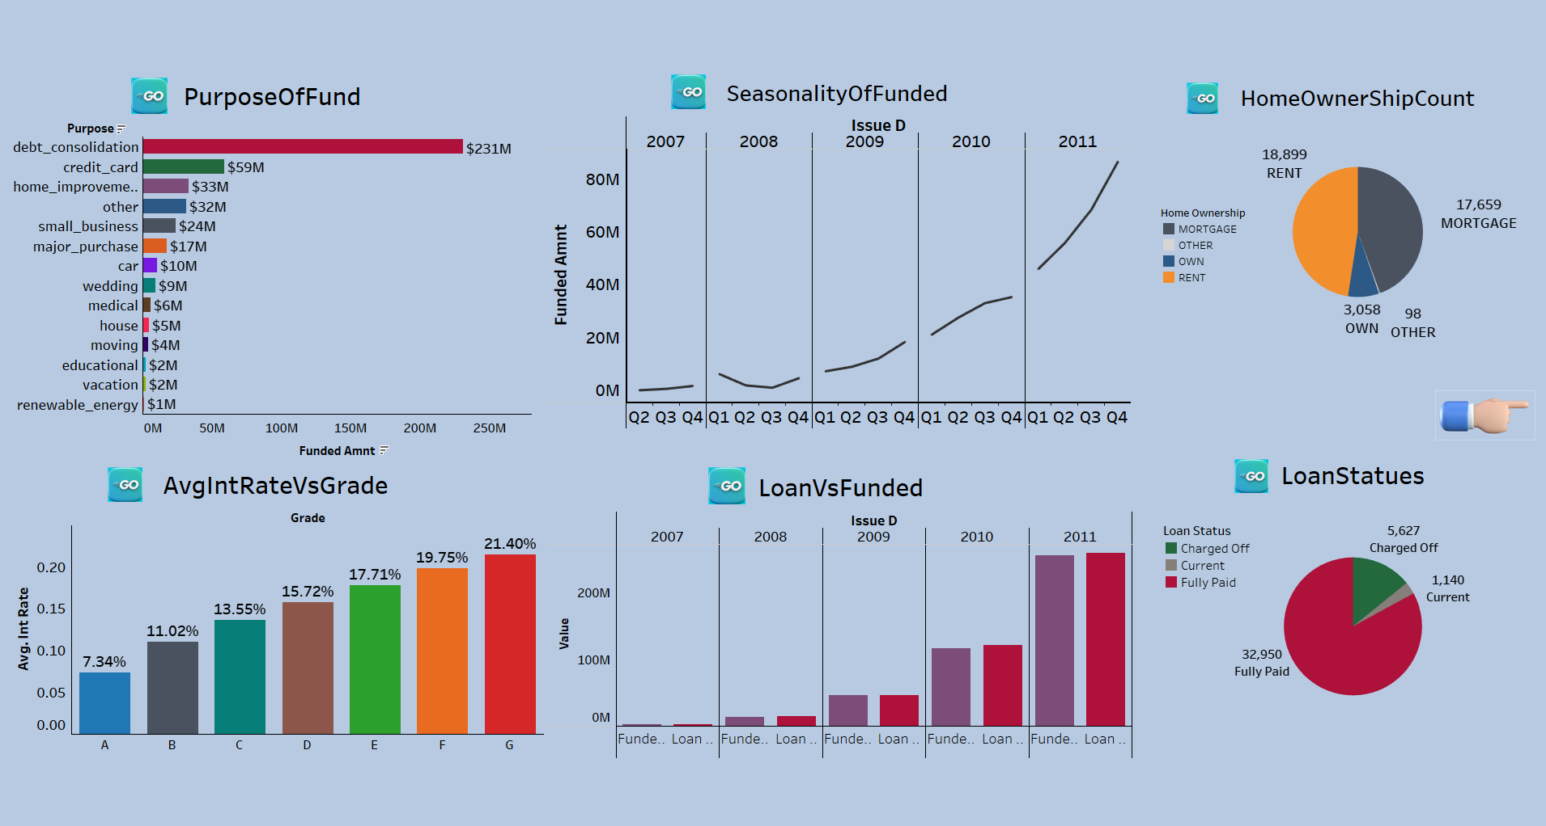
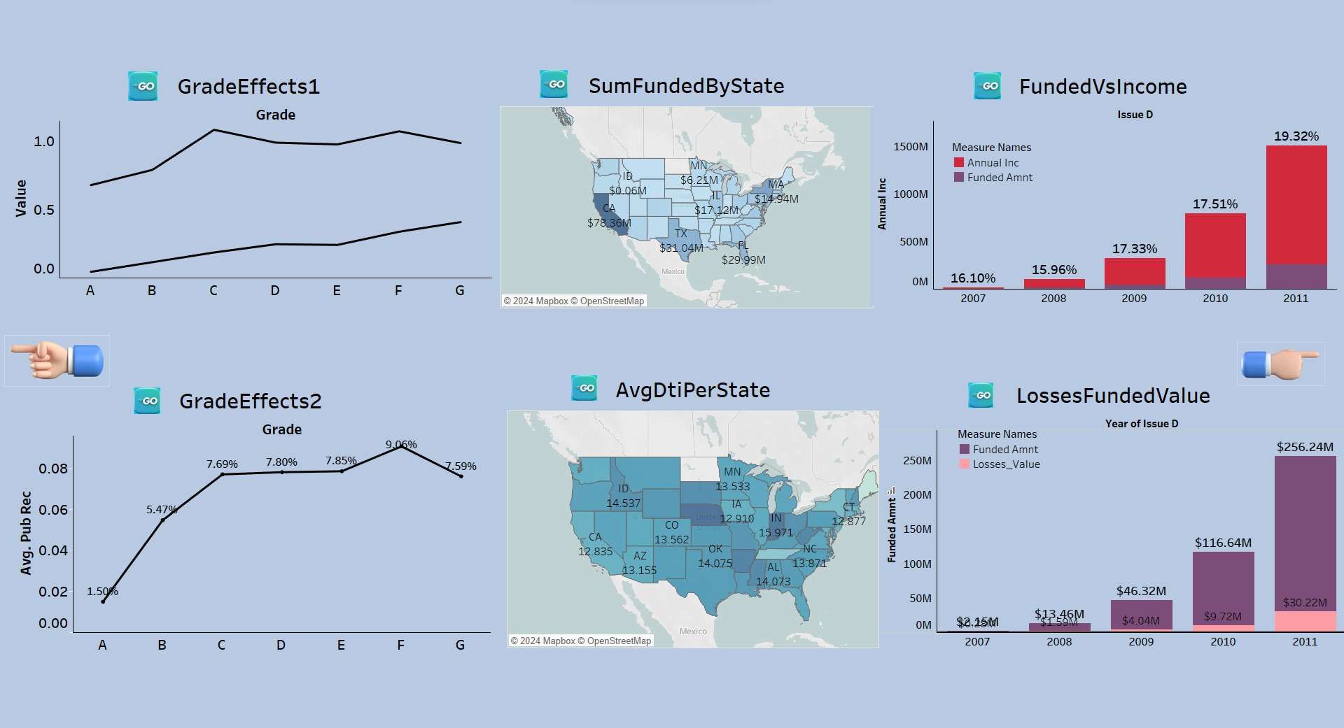
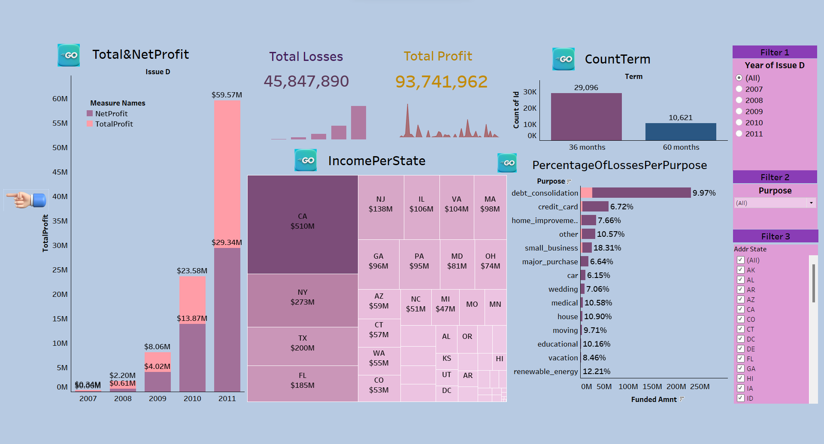
This dashboard synthesizes key bank loan metrics, tracking loan purposes, funding patterns, borrower demographics, rate trends, and repayment statuses:
Purpose: Debt consolidation tops funding at $231M, with credit card and home improvement next. Vacation and renewable energy receive the least funding.
Seasonality: Funding shows an overall rise from 2007-2011, peaking in later quarters.
Home Ownership: Renters (18,899) and mortgagees (17,659) are prevalent, few own outright (3,058), and minimal in other arrangements (98).
Interest Rates: Rates escalate from Grade A (7.34%) to G (21.40%), aligning with risk levels.
Loan vs. Funded: Annually, the funded amounts trail loan applications, hinting at selective funding.
Loan Statuses: Predominantly, loans are fully repaid (32,950), with fewer charge-offs (5,627) and active loans (1,140).

Slide 5

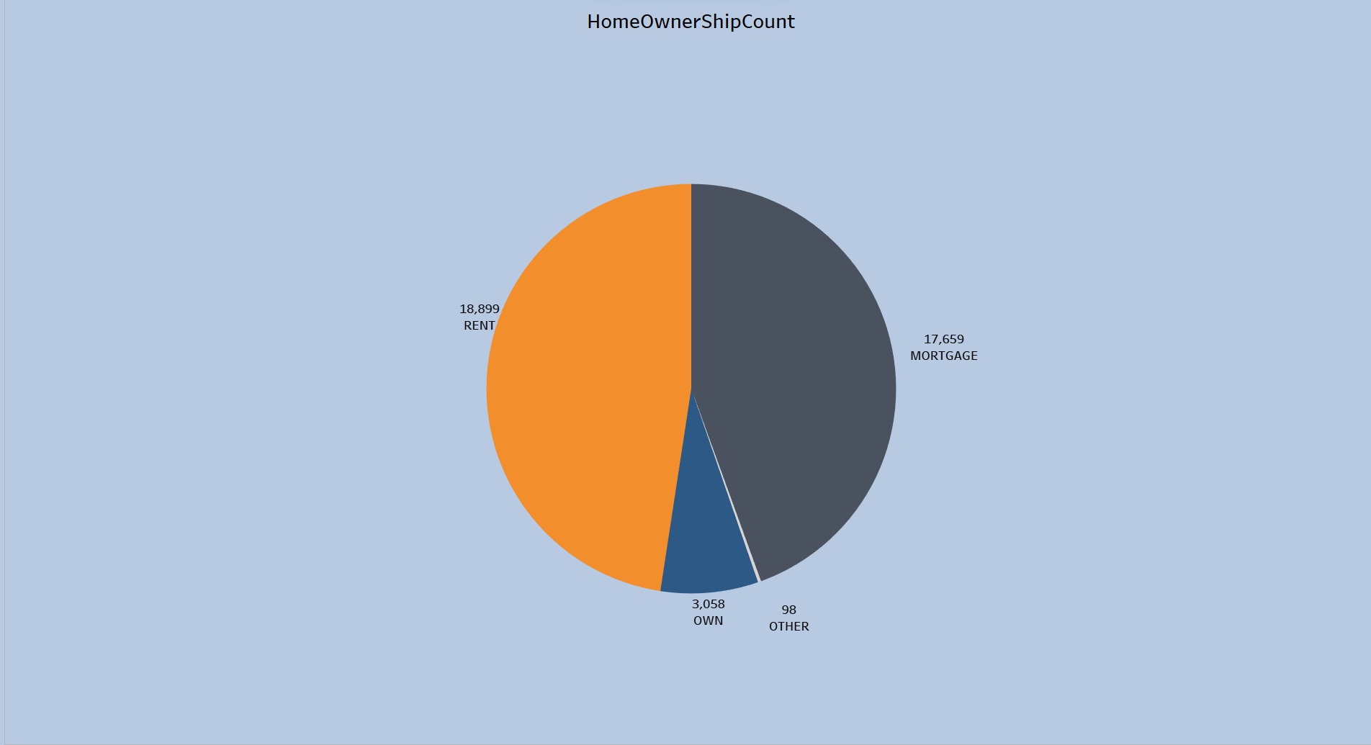
This dashboard provides a succinct overview of bank loan dynamics, revealing insights into credit behavior, regional lending, and risk trends:
Grade Effects 1: Shows minimal fluctuation in inquiries and delinquencies across loan grades, suggesting these factors are not heavily grade-dependent.
Grade Effects 2: Reveals an uptick in public records with lower loan grades, hinting at a link between reduced creditworthiness and increased public incidents.
Sum Funded By State: Illustrates funding distribution, with CA and TX as top funders, useful for targeting and risk diversification.
Avg DTI Per State: Identifies states with elevated DTI ratios, which may signal greater borrower stress.
Funded Vs. Income: Displays a rising trend in loan funding compared to income, peaking in 2011, potentially raising concerns about affordability.
Losses Funded Value: Highlights a year-on-year rise in losses, with a surge in 2011, underscoring the importance of robust risk control.

Slide 6

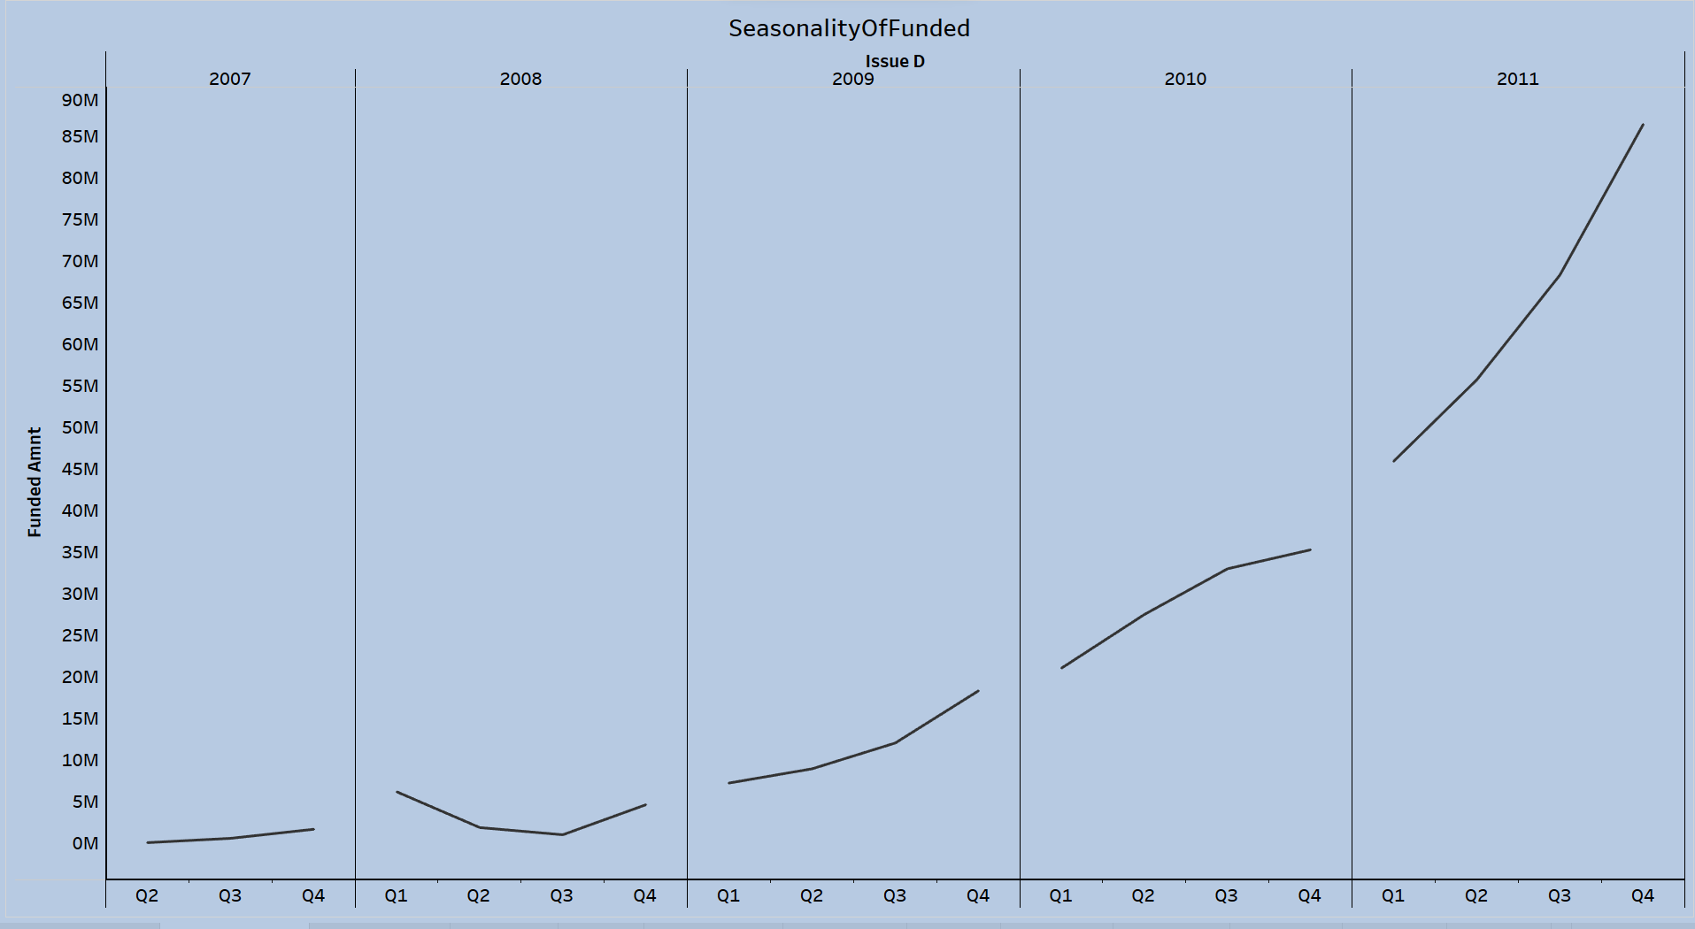
The dashboard offers an insightful snapshot of bank loan performance, showing profits and risks:
Total & Net Profit: We observe a rising profit trend through the years, with 2011 marking a substantial increase in both total and net profit, despite the latter being slightly tempered by losses.
Total Losses: Losses have intensified, particularly in 2011, suggesting that alongside the increase in lending activities, risk has also risen.
Total Profit: A notable leap in total profit in 2011 indicates a year of significant lending activity.
Income Per State: A state-wise breakdown, with California leading, reveals geographic contributions to profit.
Count Term: A strong preference for 36-month loan terms over 60 months suggests borrowers favor shorter debt commitments.
Percentage Of Losses Per Purpose: Small business loans show the highest loss percentage, pointing to higher associated risks.
Filters: The dashboard's filters facilitate detailed analysis by year, purpose, and state, allowing for targeted insights.

Slide 7

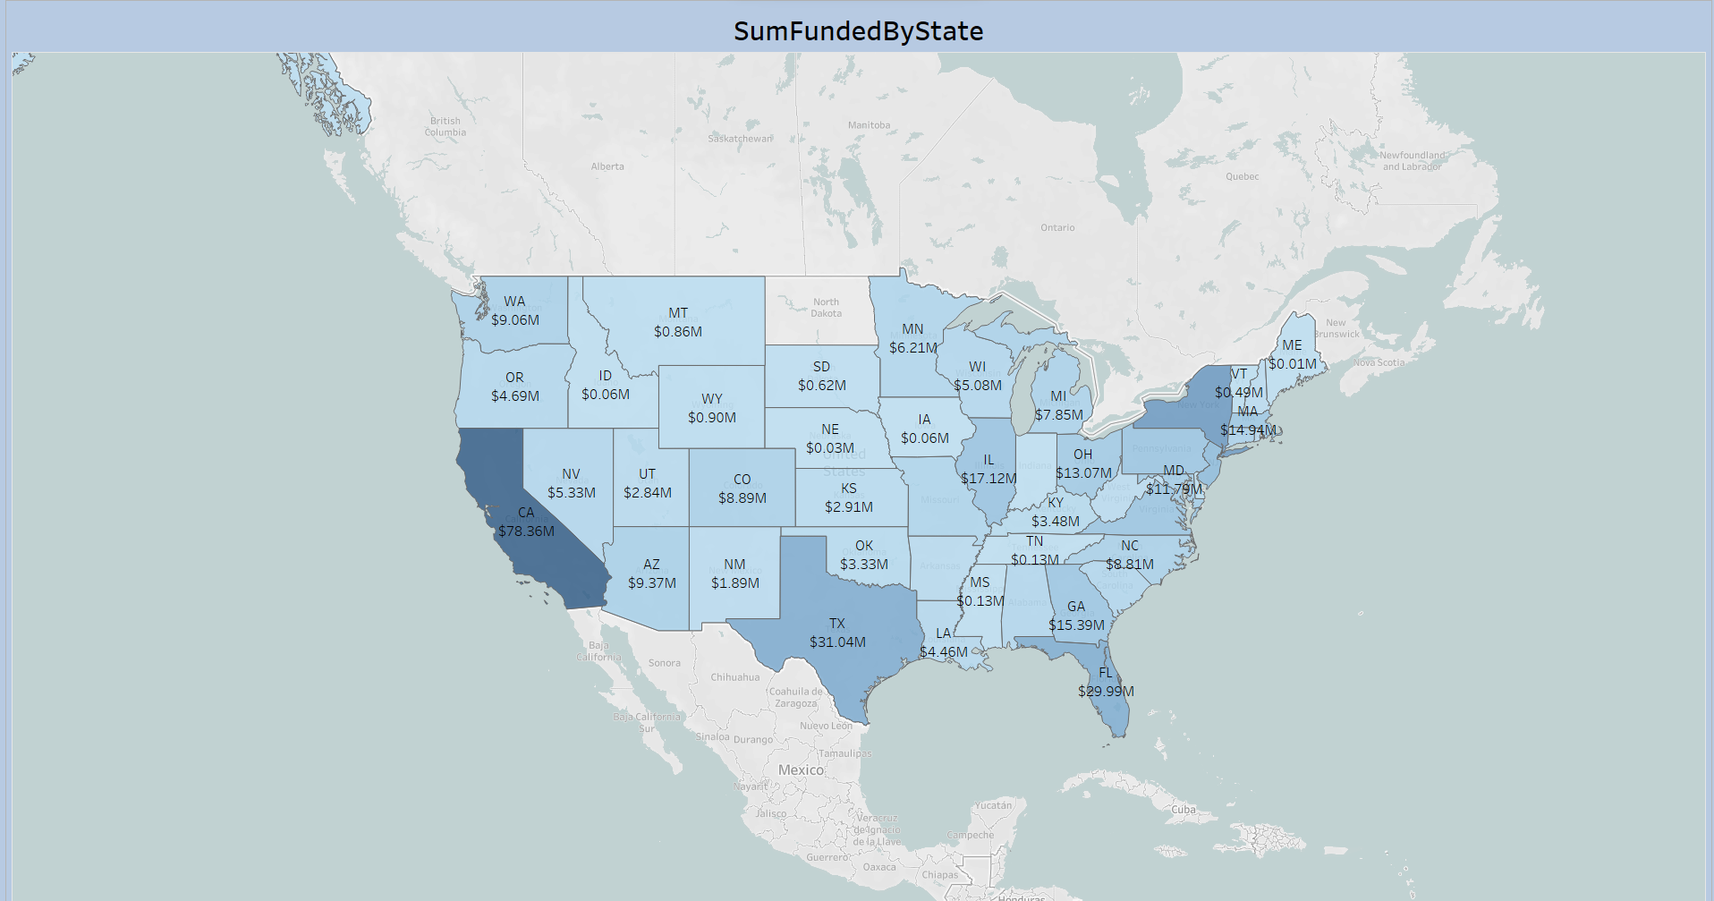
The "HomeOwnershipCount" pie chart offers a snapshot of the homeownership status among bank loan applicants:
Mortgage: Many borrowers (17,659) carry a mortgage, indicating a significant homeowner customer base.
Rent: Renters (18,899) are on par with mortgage holders, suggesting a substantial market segment.
Own: A smaller group (3,058) owns homes outright, potentially signaling greater financial freedom or lifecycle stage.
Other: Few applicants (98) are in other living situations, which might represent niche markets or data anomalies.
Overall, the data suggests a diverse borrower profile, with implications for tailored risk management and customized financial services targeting both homeowners and renters.

Slide 8

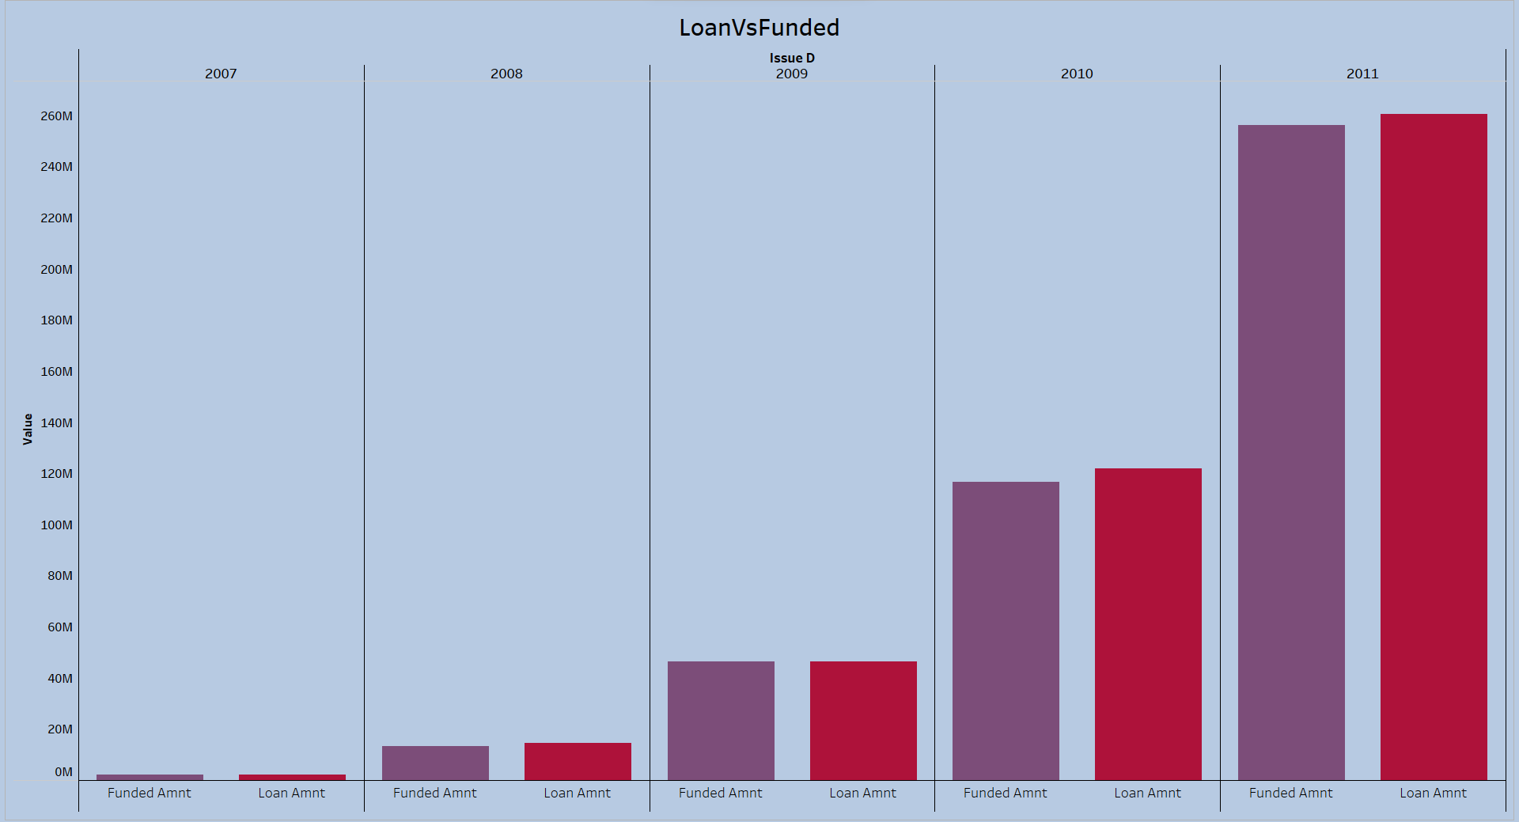
The "SeasonalityOfFunded" chart provides a clear view of lending trends over several years, highlighting growth patterns:
2007-2010: Showcases a consistent increase in lending, with seasonal peaks typically in Q4.
2011: Marks a steep increase in funding, especially in the latter half of the year.
This trend could indicate a robust economic period or rising credit demand, emphasizing the need for adaptive lending strategies to meet market needs

Slide 9

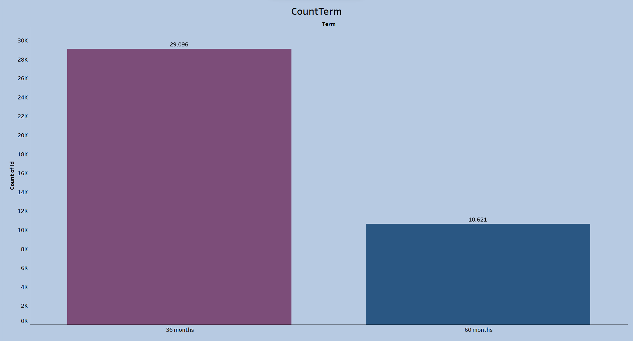
The "SumFundedByState" map showcases how bank loan distribution varies by state:
Top Funded: CA, TX, and FL lead in loan funding, suggesting high demand in populous states.
Moderately Funded: NY, IL, and GA have moderate loan volumes, showing significant market activity.
Lower Funded: States like ID, ND, and VT have smaller funding amounts, hinting at lower loan demand.
This map aids in pinpointing active lending regions and potential growth areas, guiding strategic lending and marketing initiatives.

Slide 10

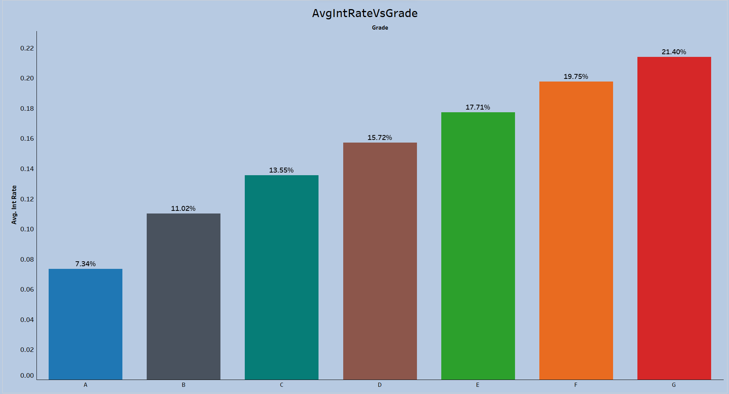
The "LoanVsFunded" bar chart outlines the trend in loan applications versus actual funding:
2007-2010: Shows a steady increase in both applied for and funded loans, with close alignment between the two values.
This pattern suggests a period of growth followed by a ca2011: Reveals a surge in applications and funding, but with a larger discrepancy, suggesting a tighter funding approach.
utious strategy in 2011, potentially reflecting a shift in risk management.

Slide 11

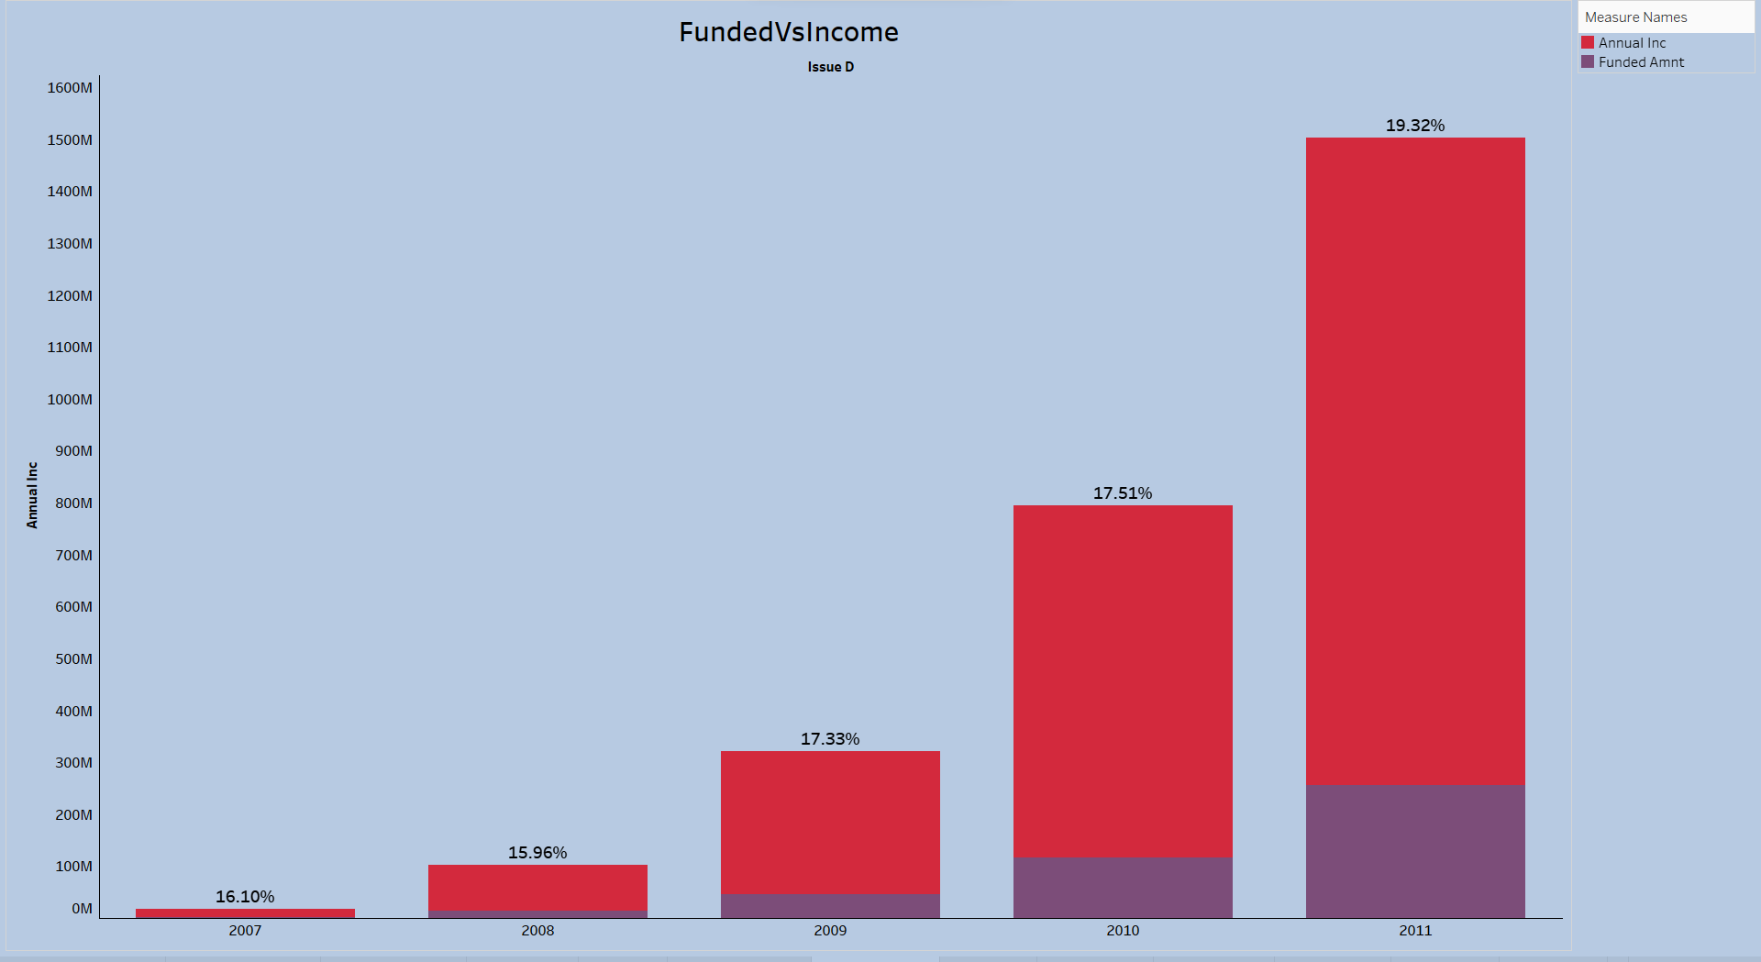
The "CountTerm" chart highlights borrower preferences in loan term lengths:
36 Months: Dominates the loan term choice, with 29,096 loans.
60 Months: Less preferred, with 10,621 loans.
This suggests a borrower inclination towards shorter loan terms, which can influence the bank's loan product offerings.

Slide 12

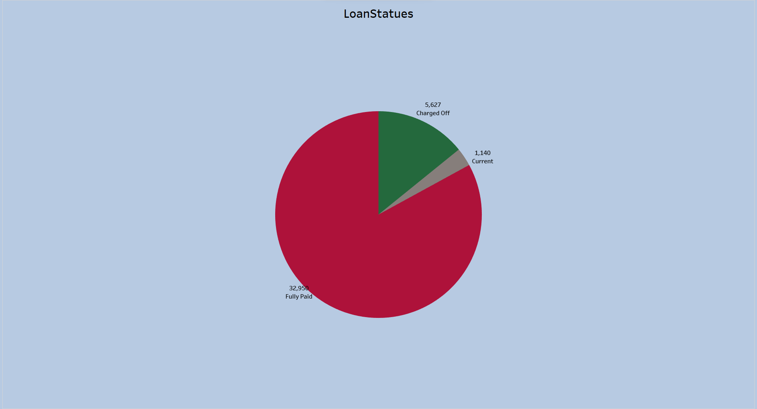
The "AvgIntRateVsGrade" chart details how loan grades correlate with interest rates:
Grade A: Offers the lowest rate at 7.34%, indicating low risk.
Grades B to D: Show rising rates from 11.02% to 15.72%, reflecting increased risk.
Grades E to G: Feature the highest rates, up to 21.40%, marking them as high risk.
This pattern highlights the risk-based pricing strategy in lending, crucial for managing the portfolio's risk-return balance.

Slide 13

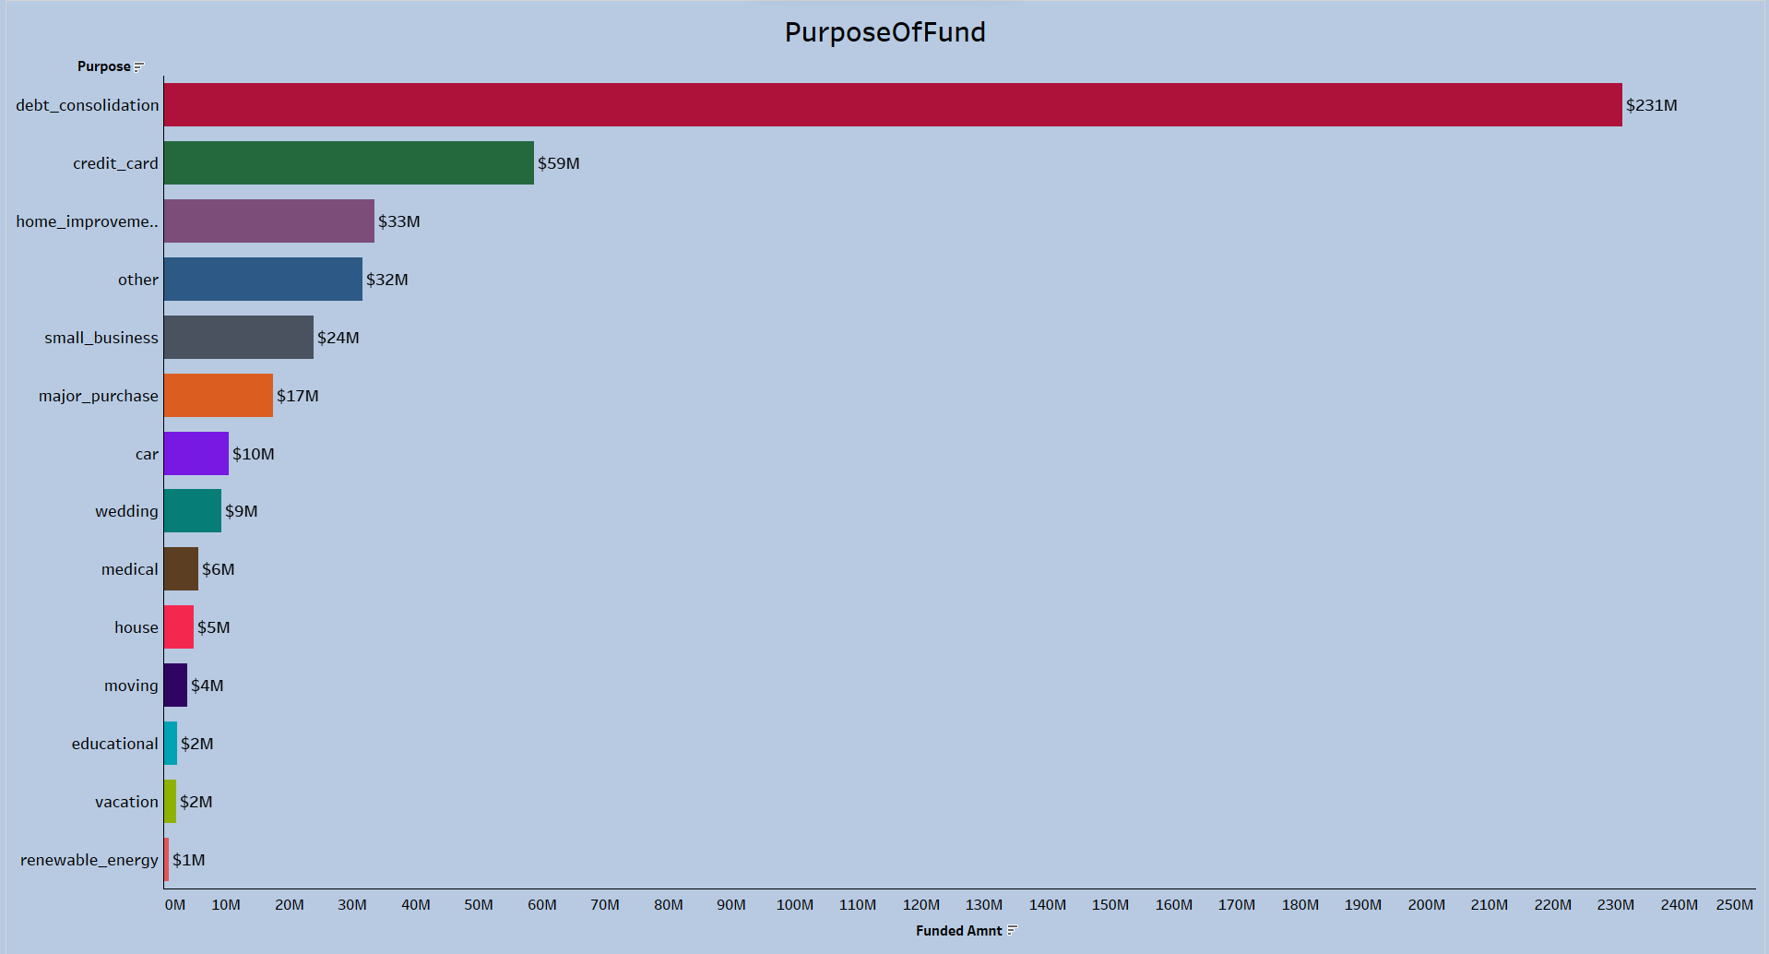
The "FundedVsIncome" chart outlines the relationship between annual income and loan funding over time:
2007-2010: Displays a steady portion of loans funded relative to income, gradually increasing.
2011: Shows a marked rise in funded loans as a percentage of income to 19.32%.
This trend suggests a potential growth in lending or larger average loans, especially in 2011, indicating an assertive lending strategy or heightened loan demand.

Slide 14

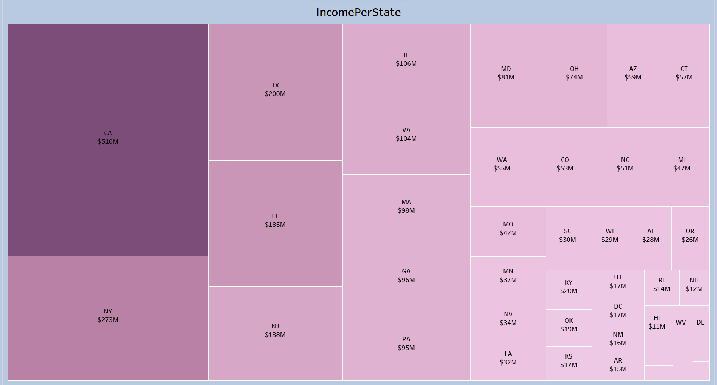
The "LoanStatuses" pie chart shows the distribution of bank loans by status:
Fully Paid: Dominates with 32,950 loans, indicating high repayment success.
Current: Represents a smaller group of 1,140 loans, all up-to-date on payments.
Charged Off: Includes 5,627 loans, signaling losses from unrecoverable debts.
This suggests a generally positive repayment trend, though charged-off loans highlight areas for potential improvement in risk management or collection efforts.

Slide 15

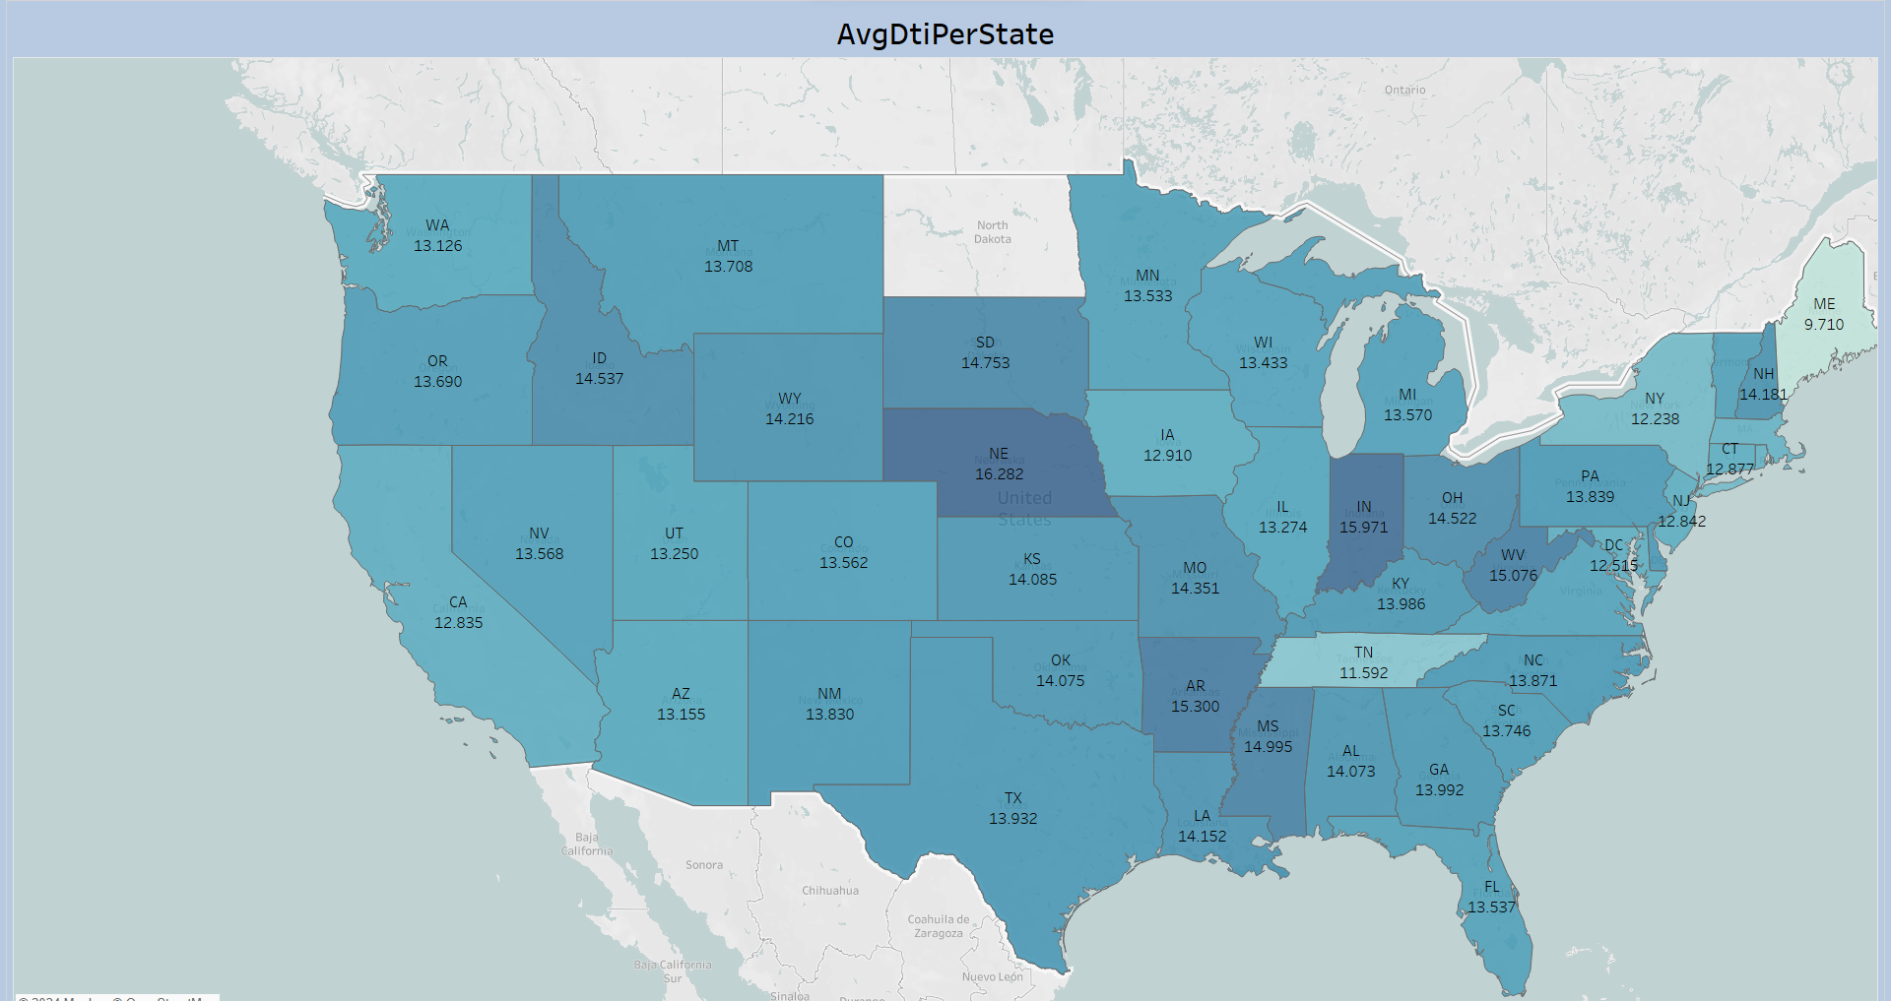
The "PurposeOfFund" chart details loan funding by purpose:
Debt Consolidation: Leads with $231 million, highlighting a key motive for loans.
Credit Card: Follows at $59 million, indicating loans are often used for managing credit debt.
Home Improvement: Stands at $33 million, showing significant investment in property upgrades.
Other Purposes: Represents a diverse group with $32 million in loans.
Small Business: Shows a notable $24 million, pointing to entrepreneurial financing.
Major Purchases and More: Includes various purposes like car purchases and education, with funds ranging from $10 million to $1 million.
This distribution suggests a focus on debt management and personal investment, guiding potential product and marketing adjustments.

Slide 16

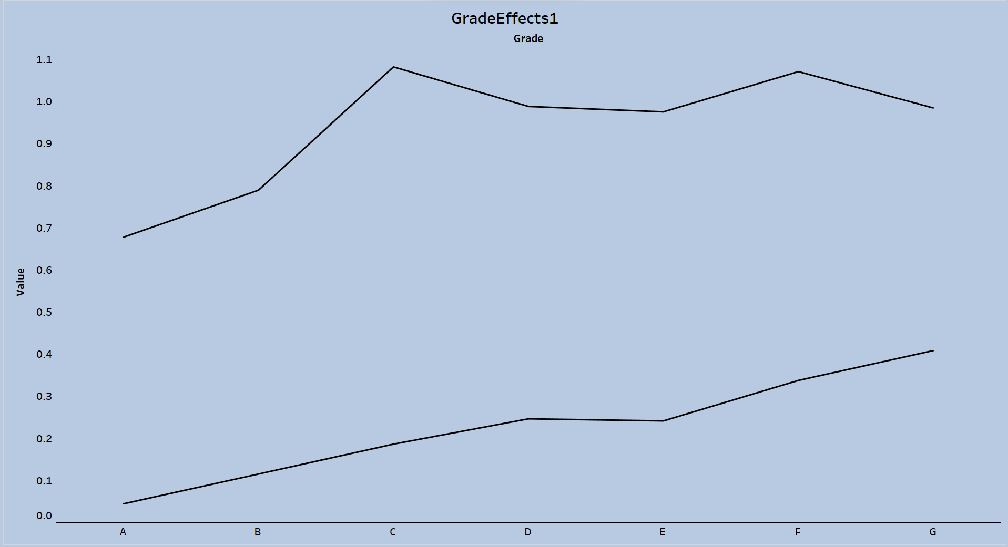
The "IncomePerState" treemap illustrates loan income distribution across the U.S.:
California (CA): Leads with $510 million, underscoring its pivotal role in the loan market.
New York (NY): Follows with $273 million, highlighting its significance in lending activities.
Texas (TX) and Florida (FL): Important markets with incomes of $200 million and $185 million, respectively.
Other States: Including IL, VA, and MA, display varying income levels, down to $12 million in NH.
This shows CA and NY as key income generators, pointing to areas of market strength and potential growth opportunities.

Slide 17

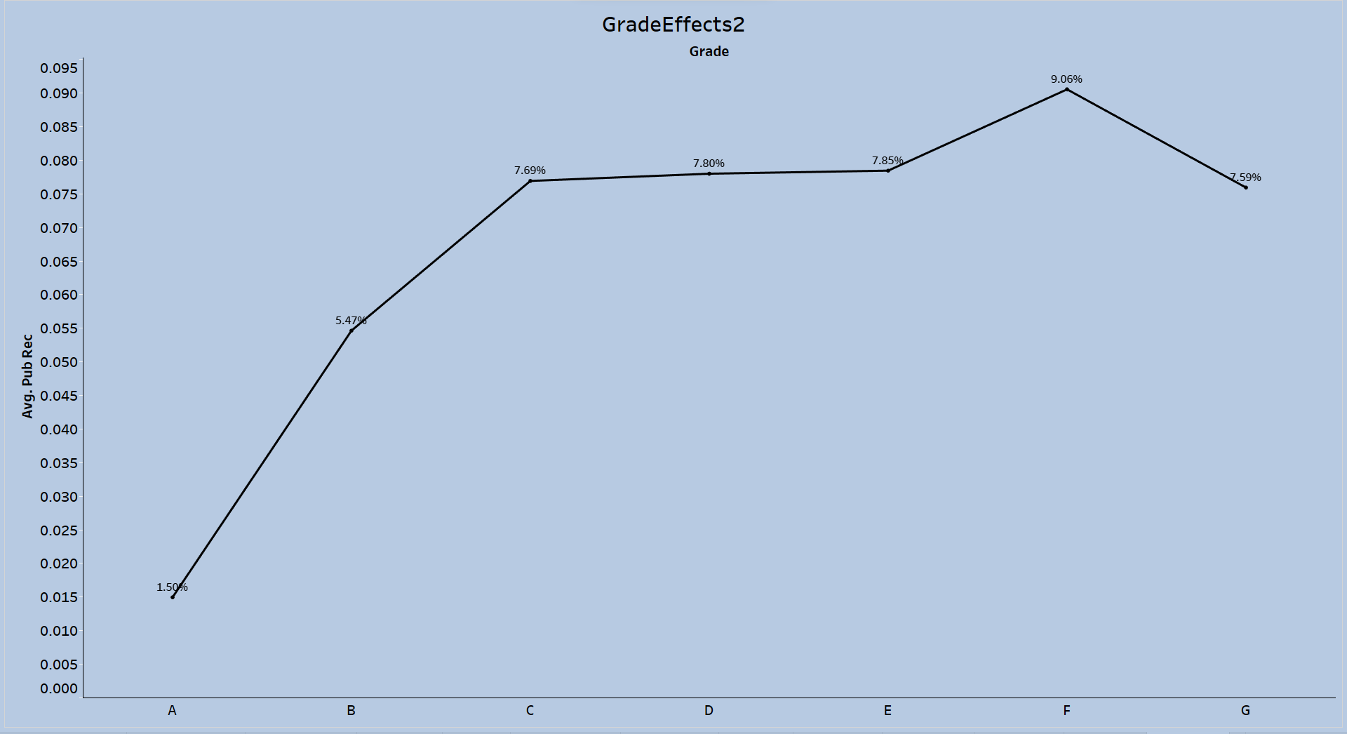
The "AvgDtiPerState" map details the debt-to-income (DTI) ratio landscape across the U.S.:
High DTI States: CO and NE stand out with the highest DTIs, suggesting greater borrower debt relative to income.
Mid-Range DTI States: Includes CA, TX, and NY, indicating moderate indebtedness.
Low DTI States: TN showcases the lowest DTI, with FL and MS also on the lower end, hinting at lesser debt burdens.
This distribution highlights the variance in financial stress by region, aiding in risk assessment and strategic lending decisions.

Slide 18

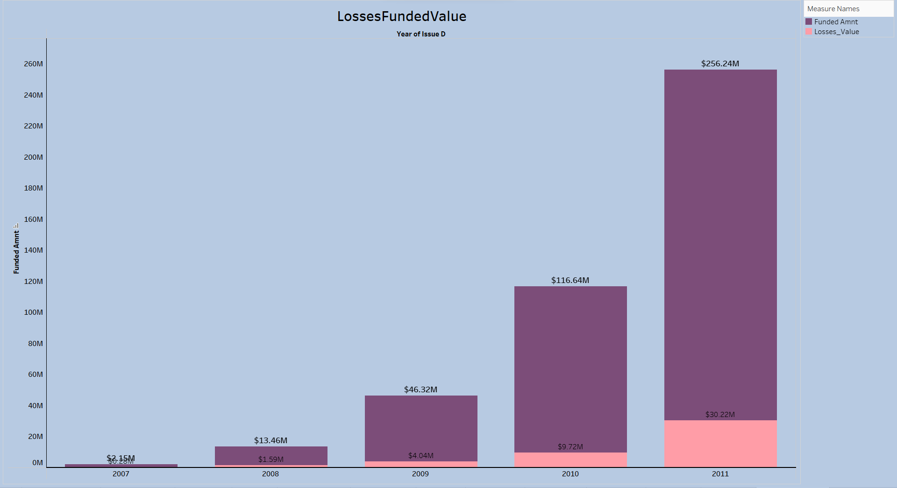
The "GradeEffects1" line graph elucidates two key loan metrics across grades A to G:
Inquiries Last 6 Months: Exhibits an upward trend, peaking at grade E, indicating increased credit-seeking behavior in mid-grades.
Delinquencies Past 2 Years: Shows a general increase in delinquencies with lower grades, highlighting higher risk in grades D to G.
This suggests lower-grade borrowers exhibit more credit inquiries and delinquencies, vital for enhancing risk assessment and refining underwriting standards.

Slide 19

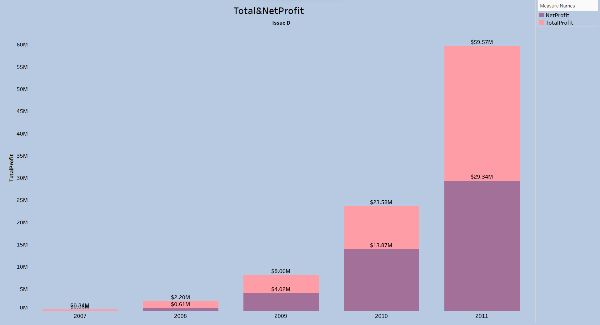
The "GradeEffects2" graph illustrates the link between loan grades and the average number of public records:
Grade A: Shows the least public records at 1.59%, implying high-grade borrowers have cleaner financial histories.
Grades B to F: Display a rising trend in public records, peaking at grade F with 9.06%, suggesting increased financial issues with lower grades.
Grade G: Sees a slight decrease in records to 7.59%, hinting at data variability or specific borrower circumstances.
This indicates a correlation between lower grades and financial distress, valuable for credit risk analysis and loan decision-making.

Slide 20

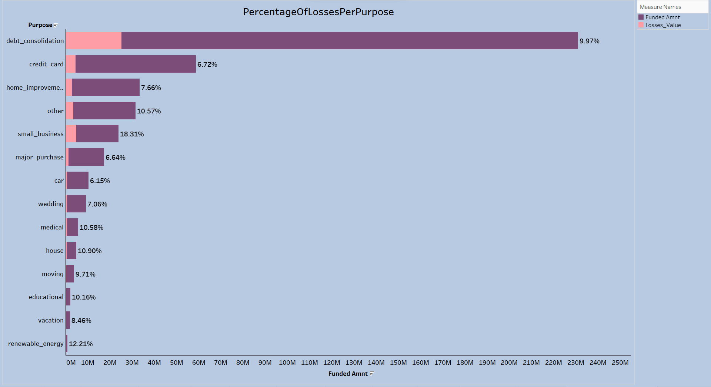
The "LossesFundedValue" bar chart showcases the growth in loan funding versus losses from 2007 to 2011:
2007-2010: Shows escalating funding alongside increasing losses, indicating rising lending activity and associated risk.
2011: Marks a peak in both funding ($256.24 million) and losses ($30.22 million), highlighting a significant expansion in lending and the resultant spike in losses.
This indicates a trend of growing lending activity with proportionately higher losses, especially notable in 2011, pointing to the need for enhanced risk management strategies.

Slide 21

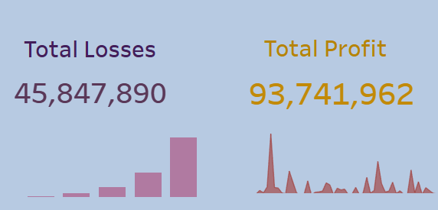
The "Total&NetProfit" chart contrasts total and net profit from 2007 to 2011:
2007-2010: Exhibits growth in both profits, with an increasing gap indicative of rising losses.
2011: Sees peak profits but a widened gap, suggesting enhanced losses impacting net gains.
The trend underscores growing profits alongside escalating losses, spotlighting concerns over loss management and the necessity for strategic adjustments.

Slide 22

The "PercentageOfLossesPerPurpose" chart details loan loss rates by purpose:
Debt Consolidation: Largest funded category, hinting at its popularity despite associated losses.
Small Business & Renewable Energy: Stand out with the highest loss rates, 18.31% and 12.21% respectively, indicating significant risk.
Medical & House: Exhibit loss rates over 10%, denoting notable risk.
Other: Shows a 10.57% loss rate, covering varied loan purposes.
Credit Card: Has a relatively lower loss rate of 6.72%.
Major Purchase, Car, & Wedding: Reflect moderate risk with 6%-7% loss rates.
Educational & Vacation: Present moderate to high risk with loss rates just above 8%.
This highlights the risk disparity among loan purposes, guiding risk management and policy adjustments, especially for higher-risk categories like small business and renewable energy.

Slide 23

Total Losses: At $45,847,890, highlight the financial impact of non-performing loans over a given period.
Total Profit: Amounting to $93,741,962, indicates robust earnings before accounting for losses.
This suggests that despite considerable losses, the bank's profit margin remains strong, with profits outpacing losses by more than two to one. However, the significance of these losses underscores the importance of enhanced risk management to sustain profitability.

Slide 24

Conclusion
The analysis reveals that while there is a growing trend in loan applications and funding, particularly for debt consolidation and seasonal upticks, there is also an increasing rate of charged-off loans, especially in small business and renewable energy sectors. The data suggests the need for a balanced approach to risk management and lending practices. Overall, the bank has a solid foundation of fully paid loans, yet the challenge lies in mitigating losses and refining the loan approval process to enhance future profitability and sustainability.
This summary encapsulates the essence of the project, presenting a narrative that aligns with the strategic decision-making process for loan management and business growth.

